Slide 1
Monitoring your Jenkins

Slide 2
What is monitoring plugin doing?
It collects various metrics about how Jenkins is performing.
It provides graphs of the metrics.
It can be configured to send email alerts when metrics deviate from user defined ranges.

Slide 3
Benefits: CPU usage
Shows the CPU usage of the System as well as by the JVM on master

Slide 4
Benefits: Heap and non-heap used
The percentage of the master’s JVM’s heap and non-heap memory pool that is currently in use.
In both case, we can see memory pressure if always over 80%

Slide 5
Benefits: File descriptors in use
The percentage of file descriptors in use by the Jenkins master
When Jenkins runs out of file handles jobs can start failing at random.

Slide 6
Benefits: Web-UI requests
The rate of web requests against the Jenkins master UI
Can monitor if the architecture of your installation needs to be upgraded

Slide 7
Benefits: The build queue
Can see when the build queue grow significantly
Build queue length
Can see if you need more slaves
Average build duration
Can detect if a job is stuck on the build queue
a job is stuck if there is no executors available and has been waiting more than 10 times its estimate build duration

Slide 8
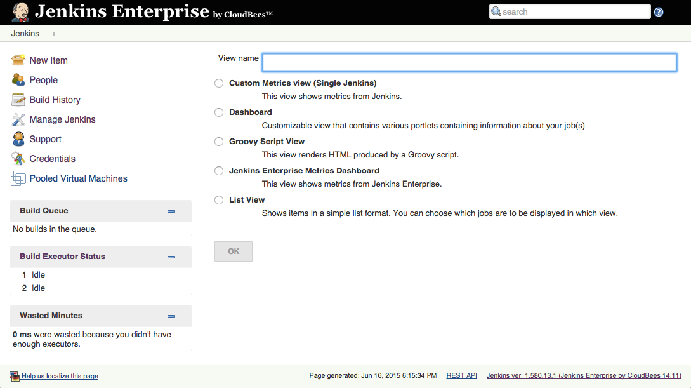
Where do we start?
Create a view at $JENKINS_URL/newView

Slide 9
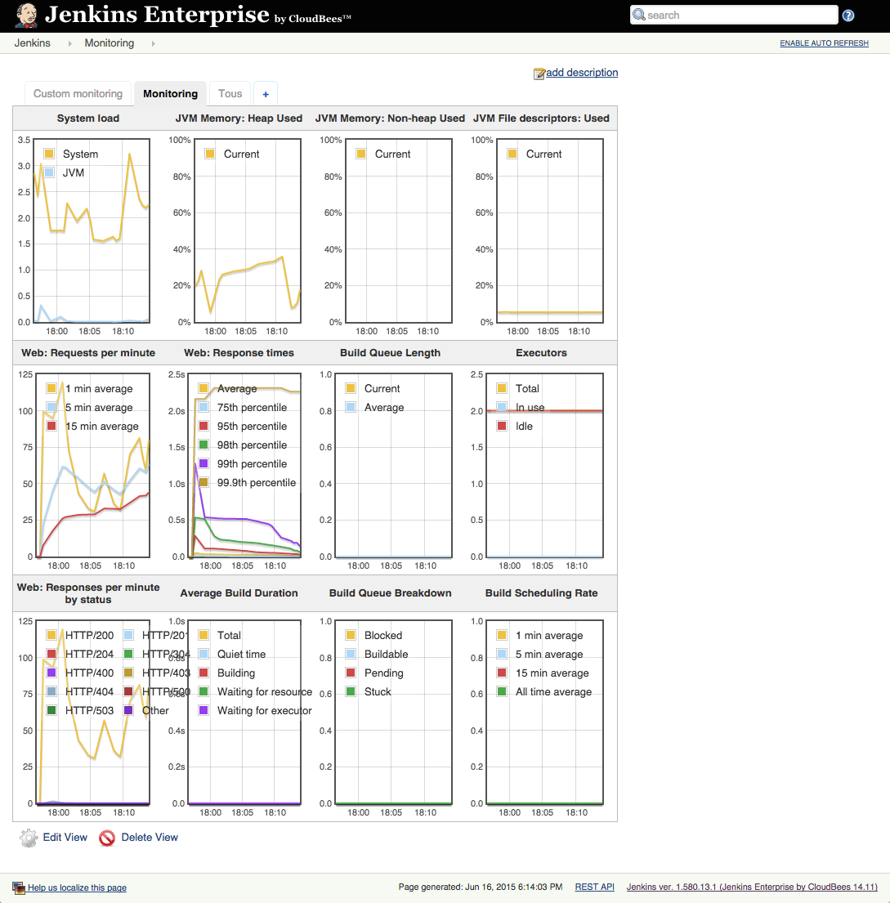
Where do we start?
Jenkins Enterprise Metrics Dashboard

Slide 10
Benefits: Jenkins Enterprise Metrics Dashboard
Simple to setup
No customization

Slide 11
Where do we start?
Custom Metrics View
Choose your design: column, overall size
Choose which metrics to display
Choose the order of the graphs
Can recreate the Jenkins Enterprise Metrics Dashboard

Slide 12
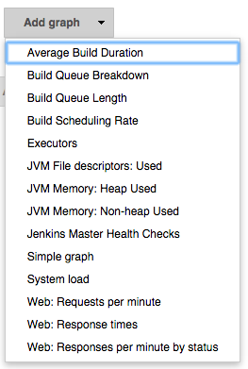
Where do we start?

Slide 13
Benefits: Alerts
Allows you to define different metrics based alerts and have Jenkins send emails when the alerts start and finish.

Slide 14
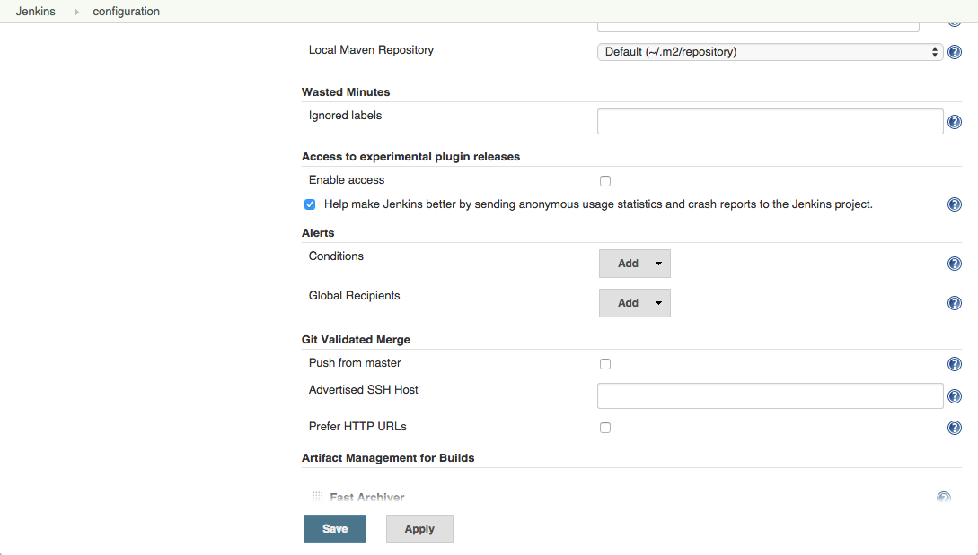
Where do we start?
In $JENKINS_URL/configure, scroll to Alerts section

Slide 15
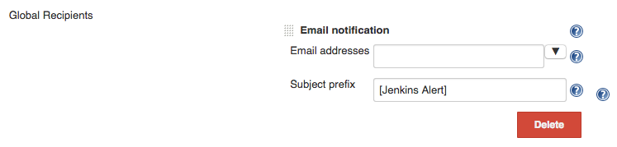
Where do we start?
Setup the Global Recipients with the email addresses to send the notifications to

Slide 16
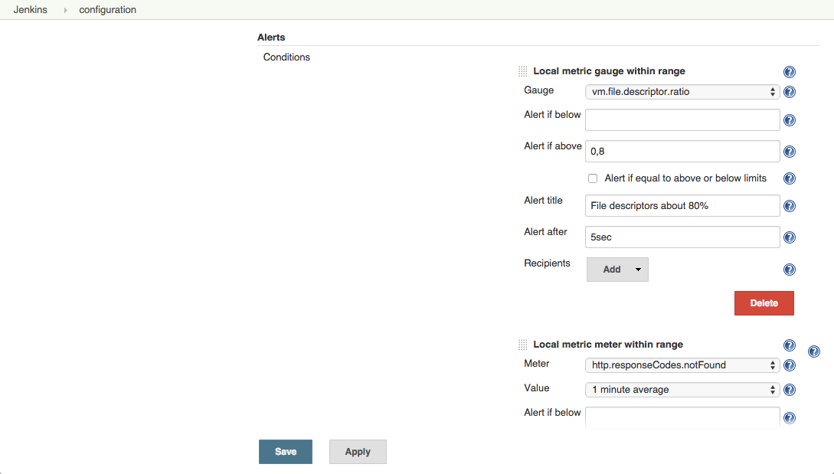
Where do we start?
Create the conditions

Slide 17
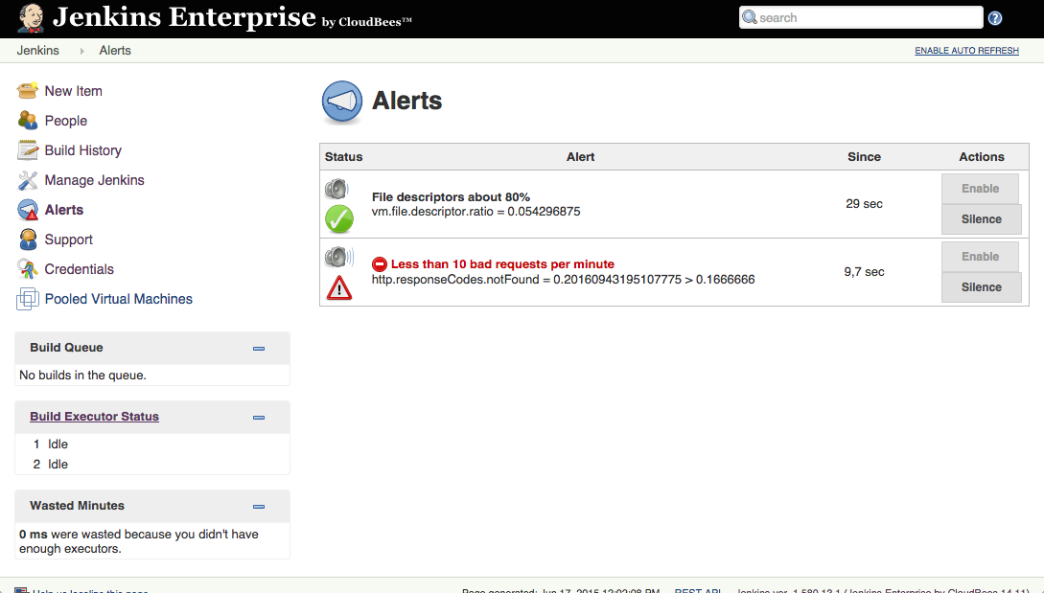
Where do we start?
Go to $JENKINS_URL/monitoring-alerts to observe the statuses

Slide 18
Lab Exercise:
Monitoring your Jenkins

